Slide 1
COMP90050:Advanced Database Systems
Professor Rao Kotagiri
Lecture Set4

Slide 2
Concurrency Problems
Shared counter = 100;
Task1/Trans/Process/Thread
counter = counter +10;
Task2/Trans/Process/Thread
counter = counter +30;
Task1 and Task2 are run concurrently. What are the possible values of counter after the end of Task1 and Task2?
For correct execution we need to impose exclusive access to the shared variable counter by Task1 and Task2.
  counter == 110;
  counter == 130;
  counter == 140;

Slide 3
Concurrency Problems
Shared counter = 100;
Task1/Trans/Process/Thread
counter = counter +10;
Task2/Trans/Process/Thread
counter = counter +30;
Task1 and Task2 are run concurrently. What are the possible values of counter after the end of Task1 and Task2?
Note: == means equals.
  counter == 110
  Sequence of actions
  T1: Reads counter == 100
  T2: Reads counter == 100
  T2: Writes counter == 100+30
  T1: Writes counter == 100+10
  b) counter == 130
  Sequence of actions
  T1: Reads counter == 100
  T2: Reads counter == 100
  T1: Writes counter == 100+10
  T2: Writes counter == 100+30
  c) counter == 140;
  Sequence of actions
  T1: Reads counter == 100
  T1: Writes counter == 100+10
  T2: Reads counter == 110
  T2: Writes counter == 110+30
Time

Slide 4
Implementation of exclusive access (atomic operations)
Dekker's algorithm
int c1, c2, turn = 1; /* global variable*/
T1
{ some code T1}
/* T1 wants exclusive access to the resource and we assume initially c1 = = 0*/
c1 = 1; turn = 2;
repeat until { c2 == 0 or turn == 1}
/* Start of exclusive access to the resource */
use the resource
counter = counter+1;
/* release the resource */
c1 = 0;
{some other code of T1}
T2
{ some code T2}
/* T2 wants exclusive access to the resource and we assume initially c2 = = 0 */
c2 = 1; turn = 1;
repeat until { c1 == 0 or turn == 2}
/* Start of exclusive access to the resource */
use the resource
counter = counter+1;
/* release the resource */
c2 = 0 ;
{some other code of T2}

Slide 5
Implementation of Atomic operations
Standard way of providing atomic operations is by means of using:
  Dekker's algorithm
    needs almost no hardware support although it needs atomic reads and writes to main memory, That is exclusive access of one time cycle of memory access time!
    the code is very complicated to implement if more than two transactions/process are involved
    harder to understand the algorithm for more than two process
    takes lot of storage space
    uses busy waiting
    efficient if the lock contention (that is frequency of access to the locks) is low

Slide 6
Implementation of Atomic operations
  OS supported primitives such as lock and unlock
    through an interrupt call, the request is passed to the operating system to implement desired lock request
    need no special hardware
    are very expensive in general (several hundreds to thousands of instructions need to be executed due to saving of context of the requesting process.)
    do not use busy waiting and therefore more effective if lock contention is high.
    solution is independent of number of processes.
    machine independent unlike the previous scheme.
    need to use spin locks to implement OS primitives in the Kernel if the system has symmetric multi processors
  All modern processors do support some form of spin locks.

Slide 7
Implementation of Atomic operations
  Atomic machine instructions such as test and set or swap instructions (Spin Locks).
  need hardware support – should be able lock bus (communication channel between CPU and memory + any other devices) for two memory cycles (one for reading and one for writing). During this time no other devices’ access is allowed to this memory location.
  are very simple to implement
  use busy waiting
  algorithm does not depend on number of processes unlike Dekker's algorithm
  are very efficient if the lock contentions are low – all database systems use them
  are necessary in symmetric multiprocessor machines.

Slide 8
Implementation of Atomic operations
Spin lock using test and set which is single atomic instruction.
  testAndSet(int *lock)
  { /* the following is executed atomically, memory bus can be locked for up to two cycles (one for read and for writing*/
  }
  Using spin for exclusive access
  int lock = 1; % initial value
  if (*lock == 1){ * lock = 0; return (true)}
  else return (false);
  T1
  /*acquire lock*/
  while (!testAndSet( &lock );
  /*Xlock granted*/
  exclusive access for T1;
  counter = counter+1;
  /* release lock*/
  lock = 1;
  T2
  /*acquire lock*/
  while (!testAndSet( &lock );
  /*Xlock granted*/
  exclusive access for T2;
  counter = counter+1;
  /* release lock*/
  lock = 1;

Slide 9
Implementation of Lock Manager ...
Atomic operation of compare and swap instruction is defined as follows:
boolean cs(int *cell, int *old, int *new)
{/* the following is executed atomically*/
if (*cell == *old)
  { *cell = *new; return TRUE;}
  else { *old = *cell; return FALSE;}
}
testAndSet( lock) == { *one = 1; *zero = 0; cs (&lock, &one, &zero) }
Note: if cs returns false the variable “one” now is set to value 0.
csd( ..) is an identical function instead of int arguments they can be double.
Example increment a counter with atomic property.
    temp = counter;
    do
      new = temp+1;
    while(!cs(&counter,&temp,&new);

Slide 10
Implementation of Lock Manager
type long PID
type struct Process{
PID pid; /*process ID*/
PCB * sem_wait; /* waiting process are put in the queue */
} PCB;
PID MyPID (void); /* returns the caller’s process ID */
PCB * MyPCB(void)
/* returns pointer to caller’s process descriptor */
void wait (void); /* suspends calling process */
void wakeup( PCB * him) wakes him.

Slide 11
Implementation of exclusive lock semaphore operations
type struct Process{
PID pid;
PCB * sem_wait;
}PCB;
typedef PCB *Xsemaphore
Void initialise( Xsemaphore *sem)
{*sem = NULL; return;}
void lock(Xsemaphore *sem)
{ PCB * new = myPCB();
PCB * old = NULL;
do
{ new ->semWait = old;
} while( ! cs(sem, &old, &new));
if (old != NULL) wait() % OS call
return;
}
void unlock(Xsemphore *sem)
{PCB * new = NULL;
PCB * old = myPCB();
if(cs(sem, &old, &new)) return;
while(old->semWait !=myPCB())
{old = old->semWait};
old->semWait = NULL;
wakeup(old); % OS Call
}

Slide 12
Lock Operations
type struct Process{
PID pid;
PCB * sem_wait;
}PCB;
typedef PCB *Xsemaphore
sem
null
Initialise(&sem):
*sem = NULL;
return;
Void initialise( Xsemaphore *sem)
{*sem = NULL; return;}

Slide 13
Lock Operations
type struct Process{
PID pid;
PCB * sem_wait;
}PCB;
typedef PCB *Xsemaphore
sem
null
P1:new
null
P1:old
P1: lock(&sem):
P1:new = PCB of P1
P1.old =null
Void initialise( Xsemaphore *sem)
{*sem = NULL; return;}
void lock(Xsemaphore *sem)
{ PCB * new = myPCB();
PCB * old = NULL;
do
{ new ->semWait = old;
} while( ! cs(sem, &old, &new));
if (old != NULL) wait() % OS call
return;
}
P1
??

Slide 14
Lock Operations
type struct Process{
PID pid;
PCB * sem_wait;
}PCB;
typedef PCB *Xsemaphore
sem
null
P1:new
null
P1:old
Void initialise( Xsemaphore *sem)
{*sem = NULL; return;}
void lock(Xsemaphore *sem)
{ PCB * new = myPCB();
PCB * old = NULL;
do
{ new ->semWait = old;
} while( ! cs(sem, &old, &new));
if (old != NULL) wait() % OS call
return;
}
P1
null
P1: lock(&sem):
P1:new = PCB of P1
P1.old =null
% Start first iteration:
new ->semWait = old;

Slide 15
Lock Operations
type struct Process{
PID pid;
PCB * sem_wait;
}PCB;
typedef PCB *Xsemaphore
sem
null
P1:new
null
P1:old
Void initialise( Xsemaphore *sem)
{*sem = NULL; return;}
void lock(Xsemaphore *sem)
{ PCB * new = myPCB();
PCB * old = NULL;
do
{ new ->semWait = old;
} while( ! cs(sem, &old, &new));
if (old != NULL) wait() % OS call
return;
}
P1
null
P1: lock(&sem):
P1:new = PCB of P1
P1.old =null
%Start first iteration:
new ->semWait = old;
P1.old == *sem ?

Slide 16
Lock Operations
sem
P1:new
null
P1:old
Void initialise( Xsemaphore *sem)
{*sem = NULL; return;}
void lock(Xsemaphore *sem)
{ PCB * new = myPCB();
PCB * old = NULL;
do
{ new ->semWait = old;
} while( ! cs(sem, &old, &new));
if (old != NULL) wait() % OS call
return;
}
P1
null
P1: lock(&sem):
P1:new = PCB of P1
P1.old =null
%Start first iteration:
new ->semWait = old;
P1.old == *sem ?
Yes: copy P1:new to sem
*sem = P1:old == PCB of P1
Condition false and exit loop;

Slide 17
Lock Operations
type struct Process{
PID pid;
PCB * sem_wait;
}PCB;
typedef PCB *Xsemaphore
sem
P1:new
null
P1:old
Void initialise( Xsemaphore *sem)
{*sem = NULL; return;}
void lock(Xsemaphore *sem)
{ PCB * new = myPCB();
PCB * old = NULL;
do
{ new ->semWait = old;
} while( ! cs(sem, &old, &new));
if (old != NULL) wait() % OS call
return;
}
P1
null
P1: lock(&sem):
P1:new = PCB of P1
P1.old =null
%Start first iteration:
new ->semWait = old;
P1.old == *sem == null therefore copy P1:new to sem
*sem == PCB of P1
Condition false and exit loop;
P1:old == NULL?
Yes: Lock granted and hence P1 returns

Slide 18
Lock Operations
sem
Void initialise( Xsemaphore *sem)
{*sem = NULL; return;}
void lock(Xsemaphore *sem)
{ PCB * new = myPCB();
PCB * old = NULL;
do
{ new ->semWait = old;
} while( ! cs(sem, &old, &new));
if (old != NULL) wait() % OS call
return;
}
P1
null
P2:new
null
P2:old
P2: lock(&sem):
P2:new = PCB of P2
P2:old = null
P2
??

Slide 19
Lock Operations
sem
Void initialise( Xsemaphore *sem)
{*sem = NULL; return;}
void lock(Xsemaphore *sem)
{ PCB * new = myPCB();
PCB * old = NULL;
do
{ new ->semWait = old;
} while( ! cs(sem, &old, &new));
if (old != NULL) wait() % OS call
return;
}
P1
null
P2:new
null
P2:old
P2: lock(&sem):
P2:new = PCB of P2
P2:old = null
%Start first iteration:
new ->semWait = old == P2:new.semWait
P2
null

Slide 20
Lock Operations
sem
Void initialise( Xsemaphore *sem)
{*sem = NULL; return;}
void lock(Xsemaphore *sem)
{ PCB * new = myPCB();
PCB * old = NULL;
do
{ new ->semWait = old;
} while( ! cs(sem, &old, &new));
if (old != NULL) wait() % OS call
return;
}
P1
null
P2:new
P2:old
P2: lock(&Xsemaphore)
P2:new = PCB of P2
P2:old = null
First iteration:
new ->semWait = old == P2:new.semWait
P2.old == *sem?
No: therefore copy sem to P2.old
Condition is true
Start 2nd iteration
P2
null

Slide 21
Lock Operations
Void initialise( Xsemaphore *sem)
{*sem = NULL; return;}
void lock(Xsemaphore *sem)
{ PCB * new = myPCB();
PCB * old = NULL;
do
{ new ->semWait = old;
} while( ! cs(sem, &old, &new));
if (old != NULL) wait() % OS call
return;
}
sem
P1
null
P2: lock(&Xsemaphore)
P2:new = PCB of P2
P2:old = null
First iteration:
new ->semWait == P2:new.semWait= old
P2.old == null and *sem == PCB of P1 therefore copy sem to P2.old
P2:old = *sem
Condition is true
%Start 2nd iteration
new ->semWait = old;
P2:new
P2:old
P2

Slide 22
Lock Operations
Void initialise( Xsemaphore *sem)
{*sem = NULL; return;}
void lock(Xsemaphore *sem)
{ PCB * new = myPCB();
PCB * old = NULL;
do
{ new ->semWait = old;
} while( ! cs(sem, &old, &new));
if (old != NULL) wait() % OS call
return;
}
sem
P1
null
P2: lock(&Xsemaphore)
P2:new = PCB of P2
P2:old = null
First iteration:
new ->semWait == P2:new.semWait= old
P2.old == null and *sem == PCB of P1 therefore copy sem to P2.old
P2:old = *sem
Condition is true
%Start 2nd iteration
new ->semWait = old;
P2.old == *sem?
Yes:copy P2:new to sem
P2:new
P2:old
P2

Slide 23
Lock Operations
Xsemaphore
Void initialise( Xsemaphore *sem)
{*sem = NULL; return;}
void lock(Xsemaphore *sem)
{ PCB * new = myPCB();
PCB * old = NULL;
do
{ new ->semWait = old;
} while( ! cs(sem, &old, &new));
if (old != NULL) wait() % OS call
return;
}
P2: lock(&Xsemaphore)
P2:new = PCB of P2
P2:old = null
First iteration:
new ->semWait = old;
P2.old == null and Xsemphore == PCB of P1 therefore copy Xsemphore to P2.old
Condition is true
Start 2nd iteration
new ->semWait = old
P2.old == *sem?
Yes: *sem = P2:new == P2:PCB
P2:old != NULL
Yes: P2 should wait
P1
null
P2:new
P2:old
P2

Slide 24
Implementation of Lock Manager ...
Convoy avoiding semaphore logic
void lock(Xsemaphore *sem)
{ PCB * new = myPCB();
PCB * old = NULL;
do
{
  new ->semWait = old;
} while( ! cs(sem, &old, &new));
if(old != NULL) {wait(); lock(sem);}
return;
}
Void initialise( Xsemaphore *sem)
{*sem = NULL; return;}
void lock(Xsemaphore *sem)
{ PCB * new = myPCB();
PCB * old = NULL;
do
{ new ->semWait = old;
} while( ! cs(sem, &old, &new));
if (old != NULL) wait();
return;
}

Slide 25
Implementation of Lock Manager ...
Convoy avoiding semaphore logic
void unlock(Xsemphore *sem)
{ PCB * new = NULL;
PCB * old = myPCB()
while(!cs(sem, &old, &new));
while(old->semWait != myPCB())
{new = old->semWait;
old->sem_wait = NULL;
wakeup(old);
old = new;
}
return;
}
void unlock(Xsemphore *sem)
{PCB * new = NULL;
PCB * old = myPCB();
if(cs(sem, &old, &new)) return;
while(old->semWait !=myPCB())
{old = old->semWait};
old->semWait = NULL;
wakeup(old);
}

Slide 26
Deadlocks
In a deadlock situation, each member of the deadlock processes is waiting for another member to release the resources it wants.
Very simple Deadlock
Resource Dependency Graph
T1
Begin
Xlock (A)
Write to A
XLOCL(B)
Write B
Unlock (A)
Unlock (B)
end
T2
Begin
Xlock (B)
Write to B
XLOCL(A)
Write A
Unlock (A)
Unlock (B)
end
T1 is waiting for Xlock for B
Xlock for A is held by T1
T2 is waiting for Xlock for A
Xlock for B is held by T2

Slide 27
Deadlocks
Solutions:
  have enough resources so that no waiting occurs
  simply do not allow a process to wait simply rollback. This can create live locks which are worse than deadlocks.
  Linearly order the resources and request of resources should follow this order. That is a transaction after requesting Ith resource can request J^{th} resource.
  if J > I .This type of allocation guarantees no cyclic dependencies among the transactions.

Slide 28
Deadlocks
Pa: Holds resources at level i and request resource at level j which are held by Pb. j > i
Pq: Holds resources at level g and request resource at level l which are held by Pd. l > g
Pb: Holds resources at level j and request resource at level k which are held by Pc. k > j
l > k > j > i and l > g.
We cannot have loops. The dependency graph can be a tree or a linear chain and hence cannot have cycles.
Pc: Holds resources at level k and request resource at level l which are held by Pd l > k
Pd: Holds resources at level l and and is currently running.

Slide 29
Deadlock avoidance/mitigation
  Pre-declare all the resources that are needed and allocate all the resources in a single request.
  Allow a transaction to wait for certain maximum time on a lock and force it to Rollback. Many successful systems (IBM, Tandem) have chosen this approach.
  Periodically check the resource dependency graph for cycles. If a cycle exists rollback (that is, terminate) one or more transaction to eliminate cycles (deadlocks). The chosen transactions should be cheap (e.g. they have not consumed too many resources).
  Many distributed database systems maintain only local dependency graphs and use time outs for global deadlocks.
  Phantom Deadlocks : Phantom dead locks can happen if we cannot build consistent dependency graphs across many independent database systems.

Slide 30
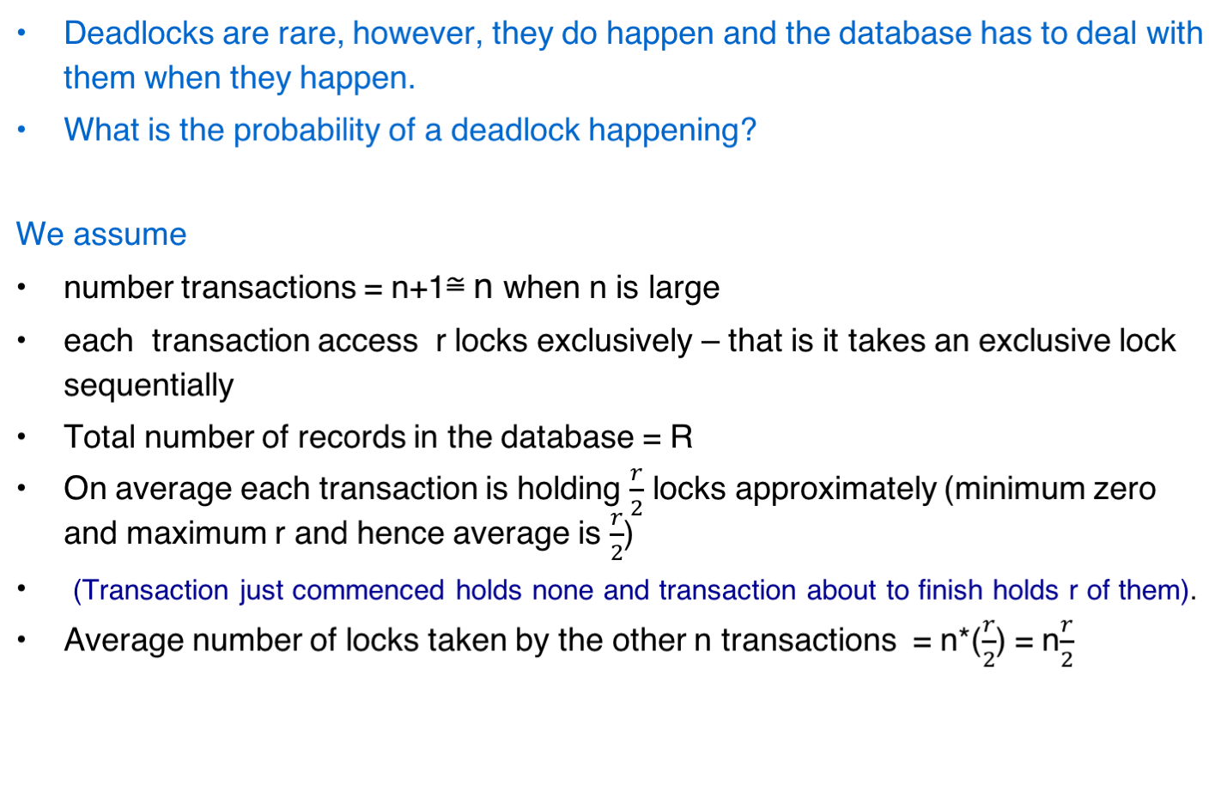
Deadlocks ...

Slide 31
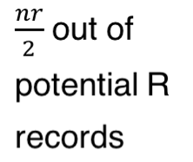

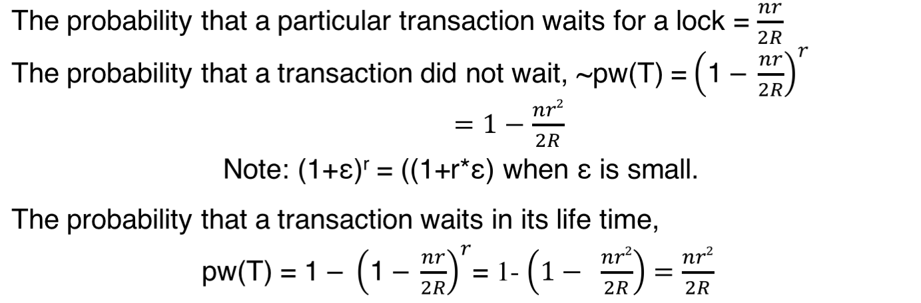
Deadlocks ...
The probability that
a particular
transaction waits for
a lock
Requesting an exclusive
lock on one of the nr/2
locks held by the other n
Transactions out of R possible locks
=
=

Slide 32
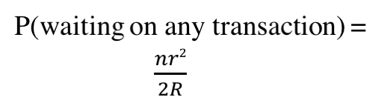

Deadlocks ...
Probability that a particular Transaction T waits for some transaction T1 and T1 waits for T is pw(T)* (pw(T1)/n) = nr⁴/4R²
Probability of any two transaction causing deadlock is = n* nr⁴/4R²
= n²r⁴/4R²
Probability of deadlock happening increases with O(r⁴) with respect to the number of lock taken and O(n²) with the number of concurrent transactions and inversely proportional to O(R²) with the size of the database.
One particular transaction in deadlock
Other
n transactions
T
waiting
T1

